Slide 1




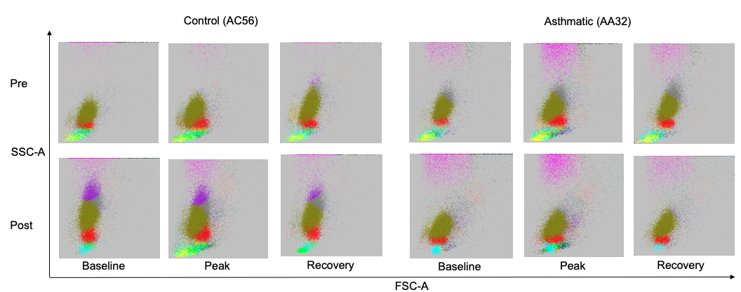
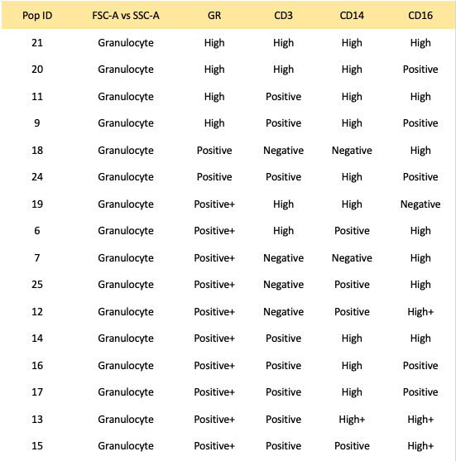
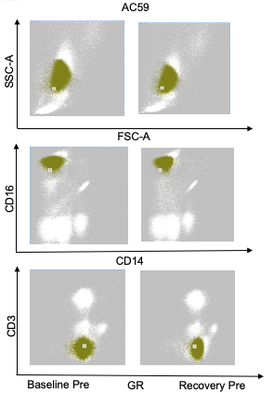
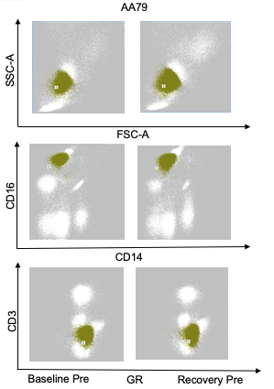
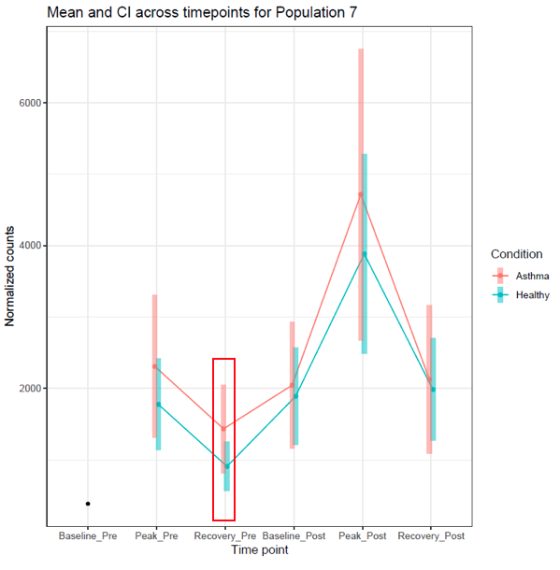
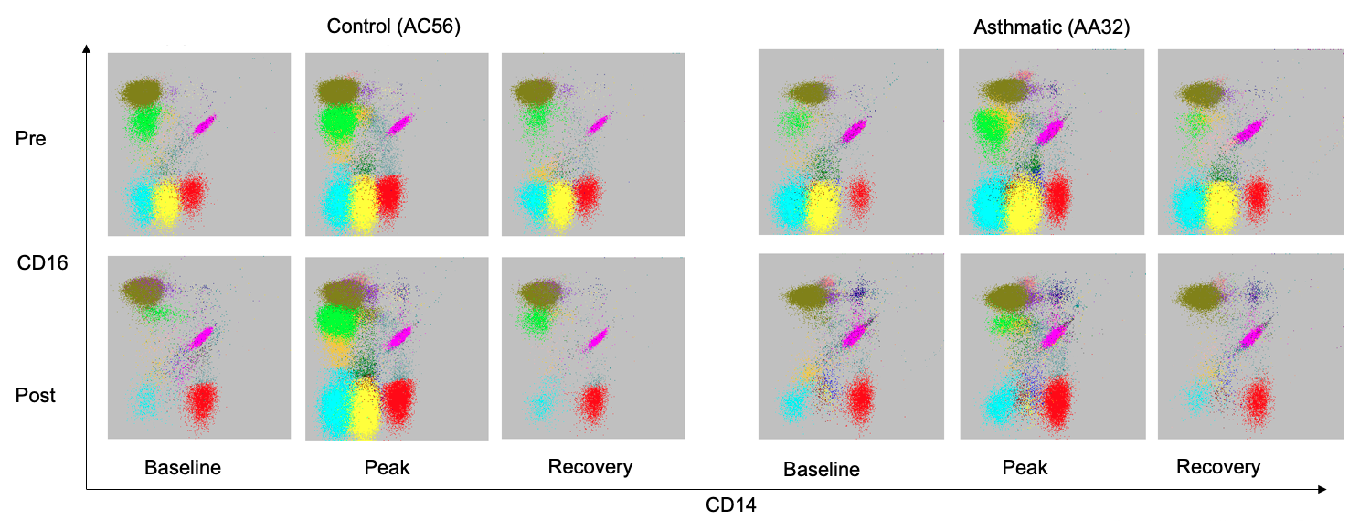
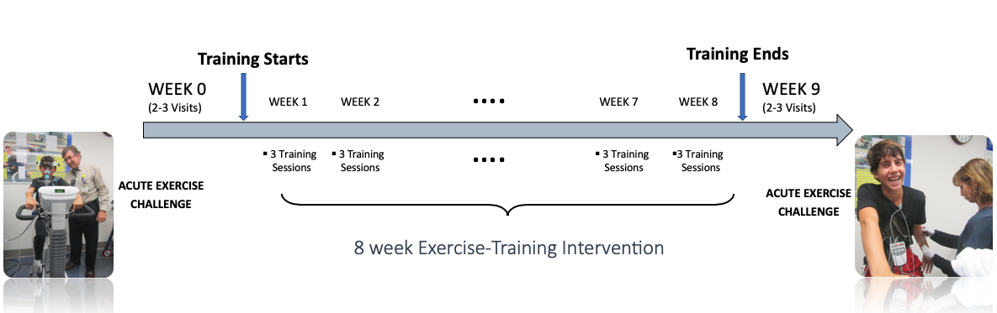
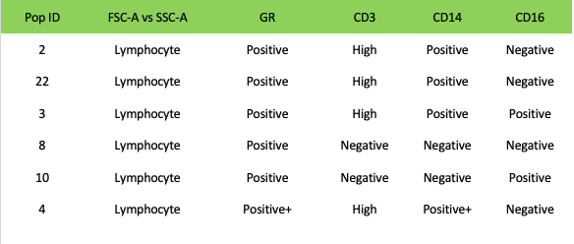
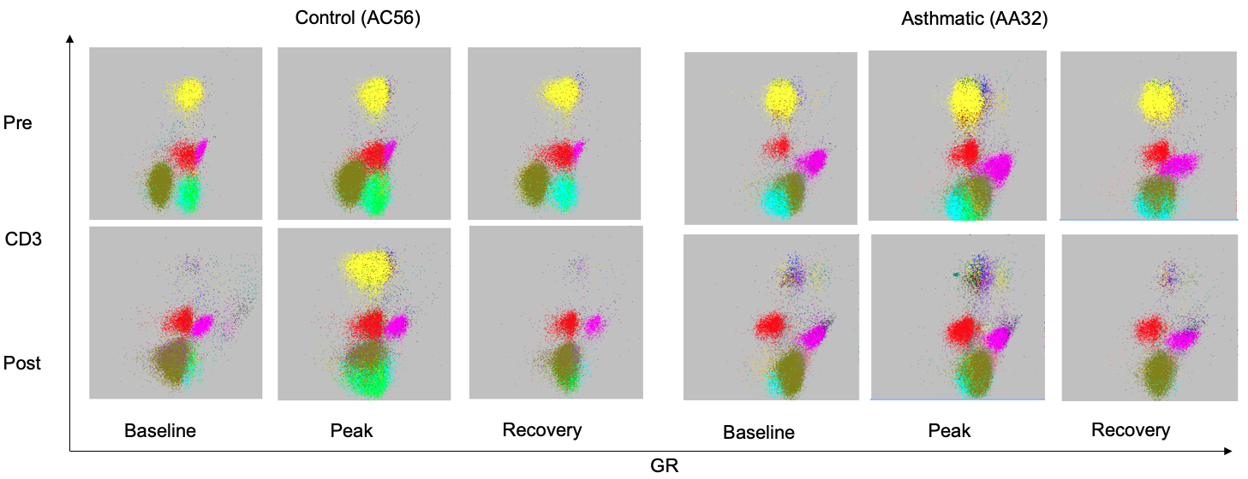
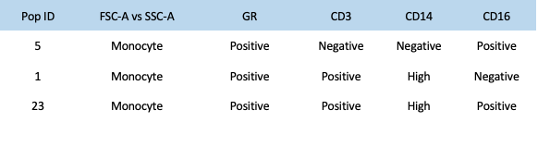
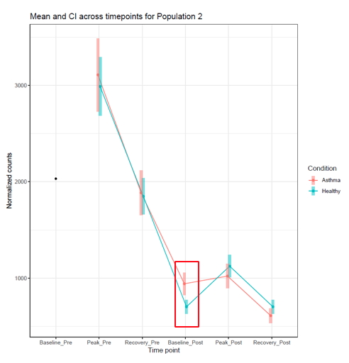
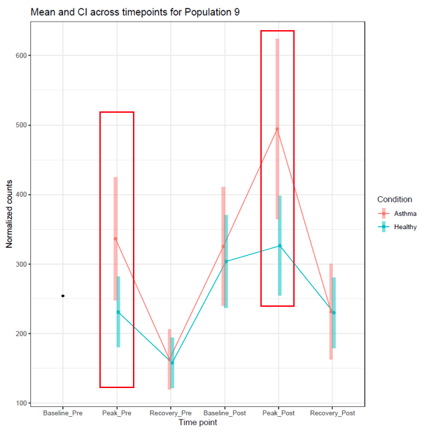
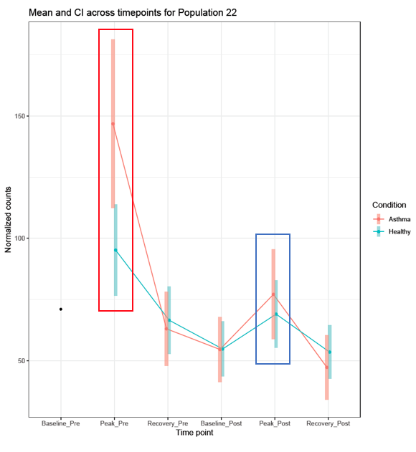
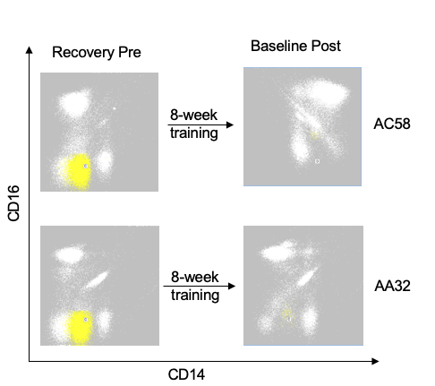
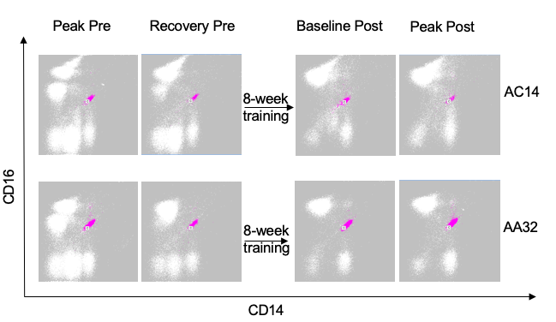
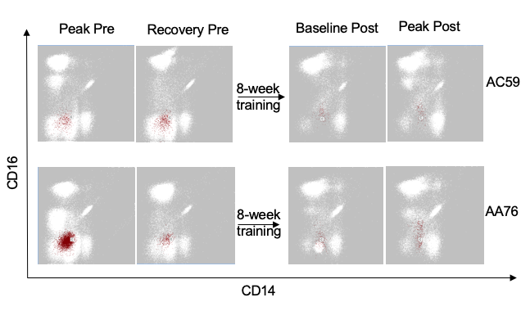

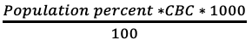
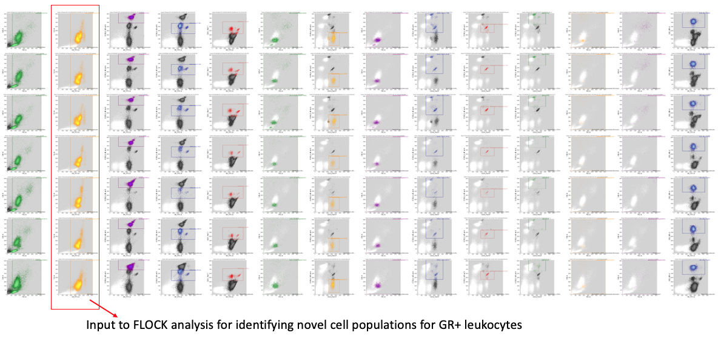
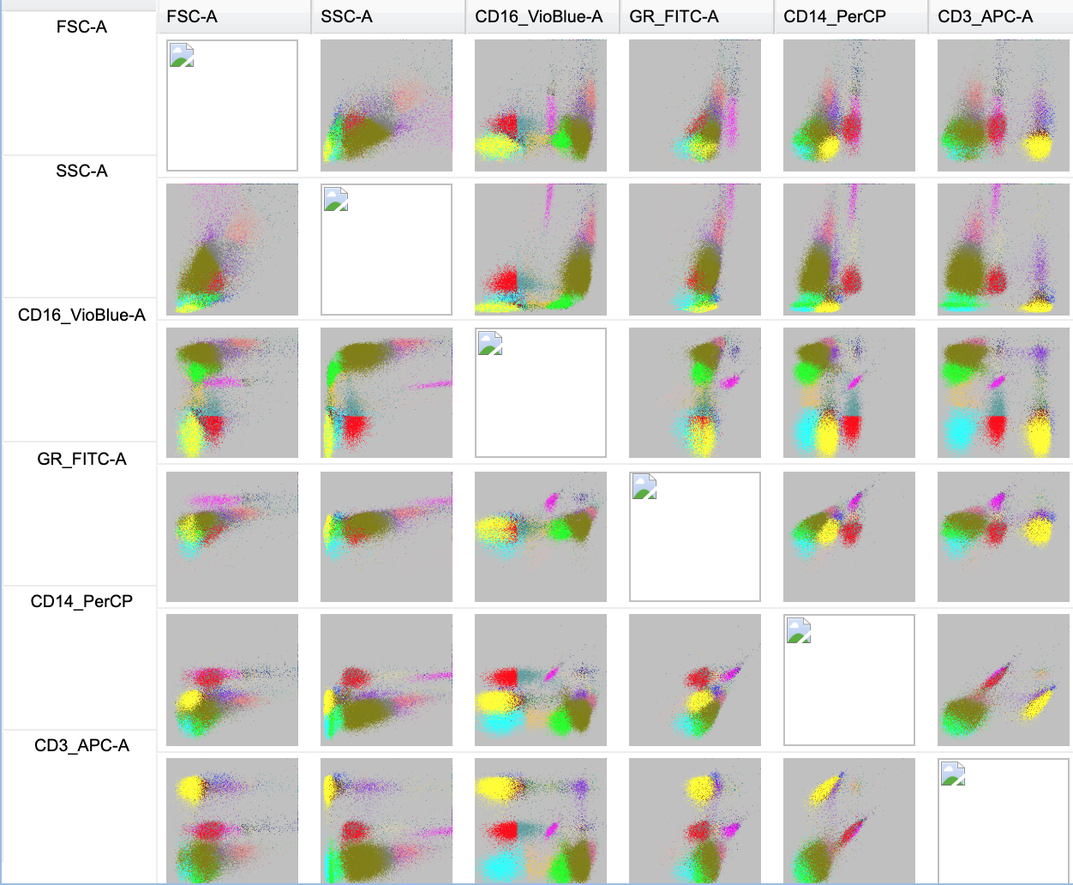
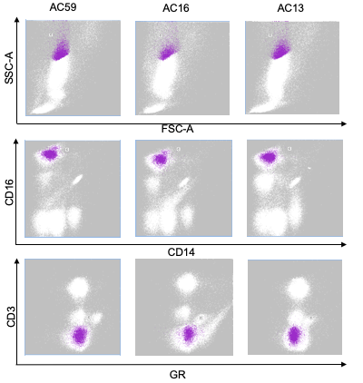
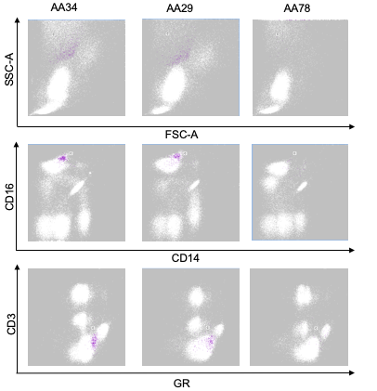
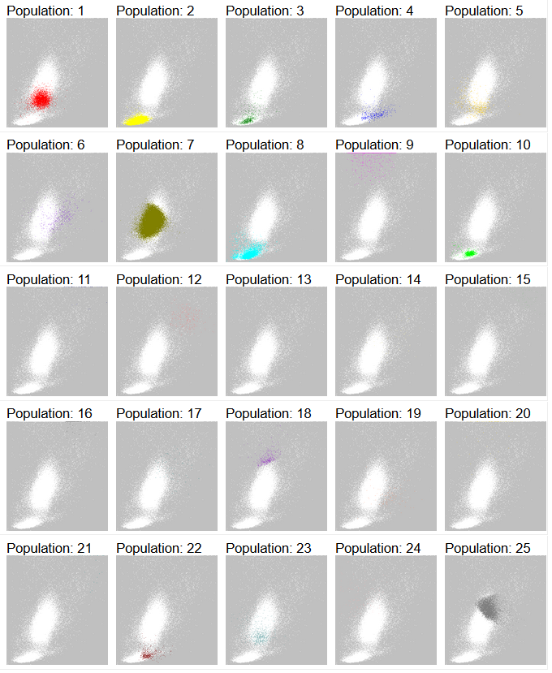
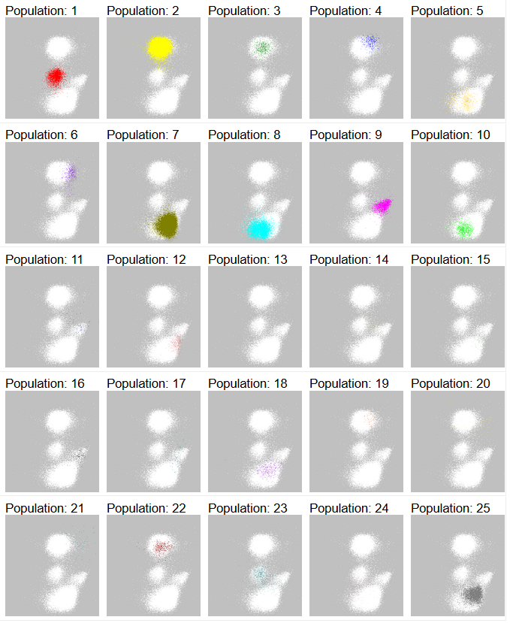
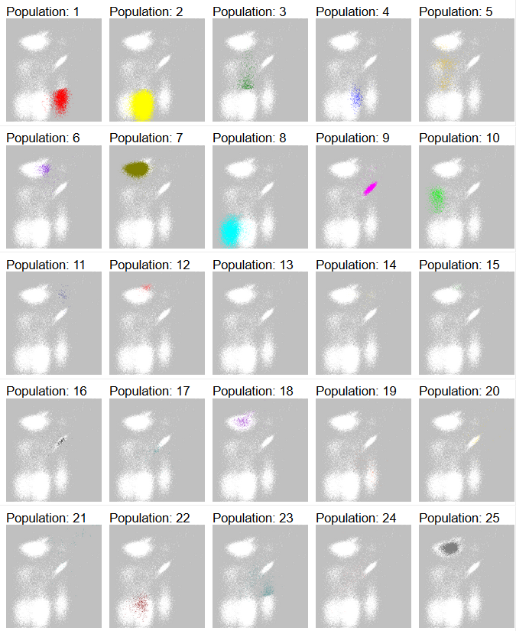
Statistical Modeling to Evaluate Exercise Training Effects on Circulating Leukocyte Subsets Identified by Auto-gating Approaches from a Published Asthma Study
Aishwarya Mandava¹, Yu Qian¹, Kim Lu², Frank Zaldivar², Shlomit Radom-Aizik², Dan Cooper², Fadia Haddad², Richard H Scheuermann^{1,3}
¹Department of Informatics, J. Craig Venter Institute, La Jolla, CA; ²Department of Pediatrics, Pediatric Exercise and Genomic Research Center (PERC), University of California, Irvine; ³Department of Pathology, University of California, San Diego, CA
Background
2) in response to the acute exercise prior to the 8-week exercise intervention
Asthma is a complex and chronic inflammatory disease.
Glucocorticoid receptor (GR) mediates the response of inhaled glucocorticoids by modulating the expression of inflammatory genes as a mechanism for controlling asthma.
Previous studies have shown that regular sessions of exercise could reduce GR expression on circulating leukocytes and relieve asthma symptoms.
Lu et al, 2018 aimed at evaluating the change of GR expression on major leukocyte subsets in response to acute exercise - baseline, peak and recovery, before and after 8-week exercise intervention.
A
B
C
A
B
Figure 6: A) There is a significant difference in the response of healthy subjects to that of asthmatic subjects to acute exercise (at recovery pre training) for population #7 (CD3-CD14lowCD16HiSSC-Alow) B) Population #7 at baseline pre training and recovery pre training for Healthy subject (AC59) C) Population #7 at baseline pre training and recovery pre training for asthmatic subject (AA79)
C
3) in response to the 8-week training intervention
D
Figure 1: Study design: Blood was drawn three times before and after the 8-week training intervention at a) baseline: prior to the acute exercise b) Peak: during the peak exercise c) 60-minutes after the peak exercise
Figure 4: Comparison between asthmatic and healthy across time for the 25 GR+ Leukocytes on A) FSC-A on x-axis and SSC-A on y-axis B) on CD14 as x-axis and CD16 as y-axis C) on CD14 as x-axis and CD16 as y-axis. Plots on the left are from healthy subject (AC56) and on the right are from Asthmatic subject (AA32). Plots in the top row are before the 8-week training intervention, with baseline, peak and recovery. Plots in the bottom row are after the 8-week training intervention with baseline, peak and recovery. D) Table shows the phenotypes of the 25 subsets identified by FLOCK.
Computational identification of leukocyte subsets
A
C
E
DAFi (Directed Automated Filtering and Identification) auto-gating method for identifying major leukocyte subsets and filtering out GR- cells
FLOCK (FLOw Clustering without K) to identify previously undefined cell subsets within GR+ Leukocytes
Statistical Modeling and post-hoc comparisons
Normalized counts calculated based on leukocyte CBC:
Generalized mixed effects model for modeling the normalized counts with negative binomial family that accounts for over-dispersion in the data.
Independent variables are condition – Asthmatic, Healthy and time points – Pre baseline, Pre peak, Pre recovery, Post baseline, Post peak and Post recovery
Estimated marginal means – for post-hoc comparisons
While comparing peak and recovery, counts were normalized to account for subject-level variation by subtracting baseline counts from them.
Comparing the leukocyte normalized counts to assess whether there is a significant difference between Healthy and Asthmatic adolescents:
B
D
F
Figure 7: A) Mean-Confidence Interval (CI) plot shows a significant difference between asthmatics and healthy subjects at Baseline after the 8-week training intervention, that is not seen after the acute training post the intervention for population #2 (CD3+CD14lowCD16-). B) Shows recovery prior to 8-week intervention and baseline post 8-week intervention for Healthy subject (AC58) and Asthmatic subject (AA32). C) Mean-CI plot shows a significantly higher count of Population #9(CD3intCD14HiCD16+SSC-AHi) in asthmatics during the peak of acute exercise prior to and post the 8-week training intervention. D) Shows population 9 for Healthy subject AC14 and asthmatic subject AA32 across 4 time points. E) Mean-CI plot shows a significantly higher count of Population #22 (CD3+CD14lowCD16lowFSC-Aint) during the first acute exercise in asthmatics, this difference was not significant after the 8-week training intervention. F) Shows population #22 for healthy subject AC59 and asthmatic subject AA76 across 4 time points
A
1) at the baseline before training intervention
B
Figure 2: A) DAFi identification of GR+ leukocyte subsets. GR+ leukocytes is input to FLOCK B) 25 GR+ Leukocyte subsets identified by FLOCK based on CD3/CD14/CD16/GR expression.
References
1. Lu KD, Cooper D, Haddad F, Zaldivar F, Kraft M, Radom-Aizik S. Glucocorticoid receptor expression on circulating leukocytes in healthy and asthmatic adolescents in response to exercise. Pediatr Res. 2017;82(2):261–271. doi:10.1038/pr.2017.66
2. Qian et al. Elucidation of Seventeen Human Peripheral Blood B cell Subsets and Quantification of the Tetanus Response Using a Density-Based Method for the Automated Identification of Cell Populations in Multidimensional Flow Cytometry Data. Cytometry Part B, Clinical cytometry, 2010.
3.. Lee et al., DAFi: A Directed Recursive Data Filtering and Clustering Approach for Improving and Interpreting Data Clustering Identification of Cell Populations from Polychromatic Flow Cytometry Data Cytometry Part A, 2018
1. NIH P01-HD048721
2. UCI CTSA grant ULI TR000153
3. Children’s Hospital of Orange County – UCI Child Health Research Award
4. NCATS U01TR001801 (FlowGate)
A
B
C
Acknowledgements
A
B
C
Figure 5: A) There is a significant difference in the GR expression between Healthy subjects and Asthmatic subjects at baseline before the 8 week training intervention in Population #18 (CD3-CD14lowCD16HiSSC-AHi). B) Population #18 in three Healthy samples AC59, AC16 and AC13. C) Population #18 in three Asthmatic samples AA34, AA29 and AA78
Figure 3: 2D dot plots of the 25 GR+ Leukocyte cell subsets on A) X: FSC-A ; Y: SSC-A B) X: GR; Y: CD3 C) X: CD14 Y:CD16

